Slide 1
Searching strategies

Slide 2
Uninformed Search

Slide 3
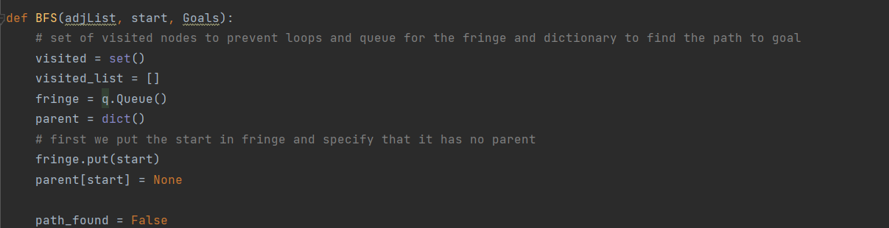
1-Breadth First search
Creating a list to hold the visited nodes so we can return the visited nodes in order
Creating a set to hold the visited nodes
Initialization
Fringe is used as a Queue (FIFO).
Creating a dictionary to hold the parent of each node reached in the graph. Will be used to get the solution path at the end.
Adding the start node to the fringe and specifying that it has no parent in the dictionary
Initialize that a path is not found

Slide 4
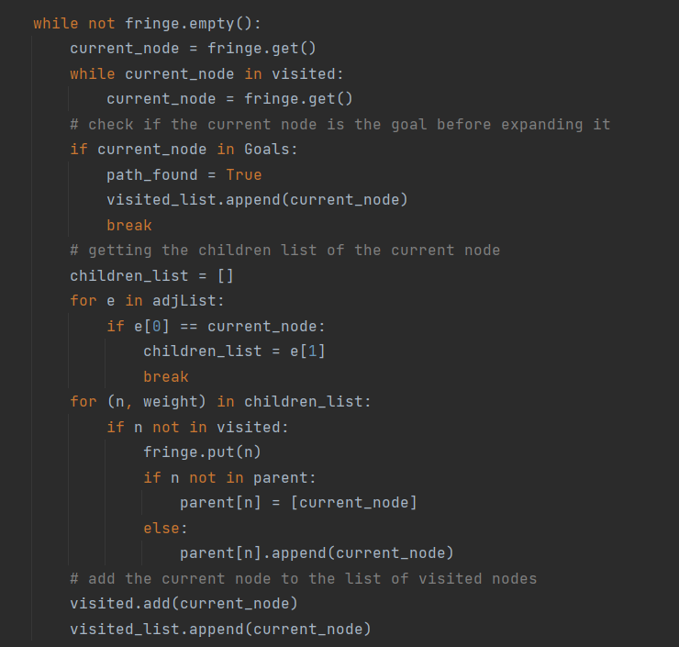
1- Breadth First search
Looping
Get the node that is supposed to be expanded from the queue (first in the fringe) and make sure it isn’t visited before.
Check if the current node is the goal before expanding it if it is the goal set goal is found and exit loop
For each child of the current node we check if it isn’t visited and add it to the fringe with setting its parent as the current node being expanded. And we add that this node is reached through which parent node in the dictionary. The parent is put as a list in the dictionary as a node can have multiple parents we do this so the parent giving the shallowest path doesn’t get overwritten
Add the current node to the list of visited nodes

Slide 5
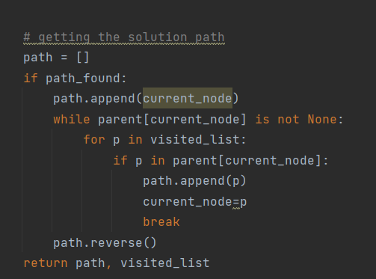
1- Breadth First search
Finding the path to goal
If we exited the while loop due to finding a goal the we enter this loop that uses the dictionary called parent to find the solution path by inserting the nodes from the goal up to the starting node in a list then reversing the list.
If a node has multiple parents we choose the parent that was expanded first (added to the parent list in the dictionary first) to get the shallowest path.
Return the path and the list of visited nodes in order to be displayed in the program

Slide 6
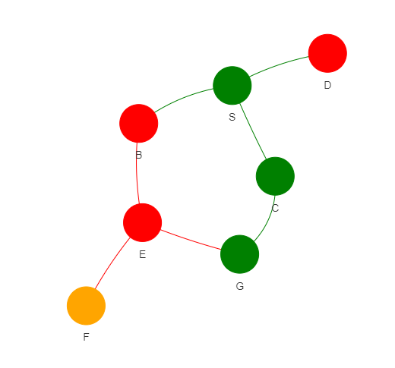

1- Breadth First search
How the implemented algorithm handles this graph
Initially S enters the Queue as it is not the goal it is added to the visited list then expanded getting its children B-C-D. as it is FIFO B is visited first
B is then visited and as it is not the goal it is added to the visited list then expanded getting its child E.
C is then visited and as it is not the goal it is added to the visited list then expanded getting its child G.
D is then visited and as it is not the goal it is added to the visited list.
E is then visited and as it is not the goal it is added to the visited list then expanded getting its children F-G.
Next in the Queue is G which is the goal so the goal is marked as reached and the solution path is generated
G has two parents E-C however the algorithm recognizes the first expanded parent and returns the correct solution path which is the shallowest

Slide 7
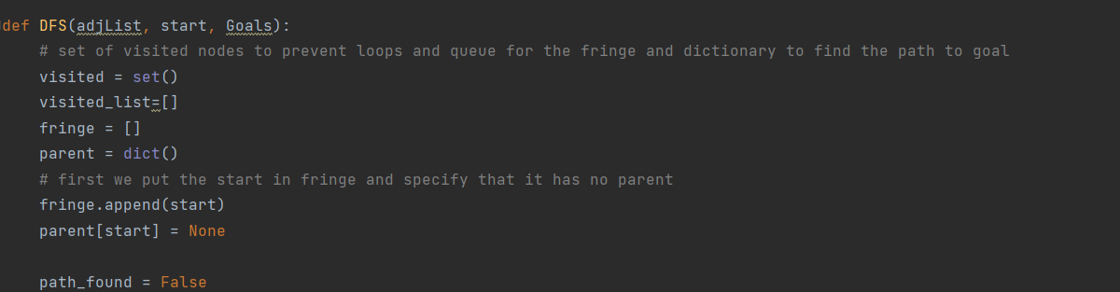
2-Depth First search
Creating a list to hold the visited nodes so we can return the visited nodes in order
Creating a set to hold the visited nodes
Initialization
Creating a dictionary to hold the parent of each node reached in the graph. Will be used to get the solution path at the end.
Adding the start node to the fringe which acts as a stack. and specifying that it has no parent in the dictionary
Initialize that a path is not found

Slide 8
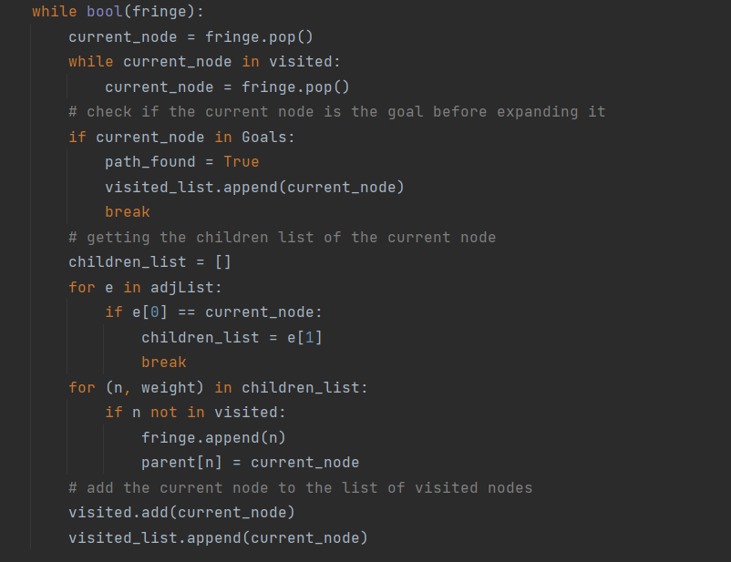
2- Depth First search
Looping
Popping the last node to enter the fringe that is supposed to be expanded and make sure it isn’t visited before.
Check if the current node is the goal before expanding it if it is the goal set goal is found and exit loop
For each child of the current node we check if it isn’t visited and add it to the fringe with setting its parent as the current node being expanded. And we add that this node is reached through which parent node in the dictionary.
Add the current node to the list of visited nodes

Slide 9
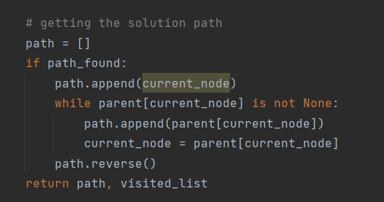
2- Depth First search
Finding the path to goal
If we exited the while loop due to finding a goal the we enter this loop that uses the dictionary called parent to find the solution path by inserting the nodes from the goal up to the starting node in a list then reversing the list.
Return the path and the list of visited nodes in order to be displayed in the program

Slide 10
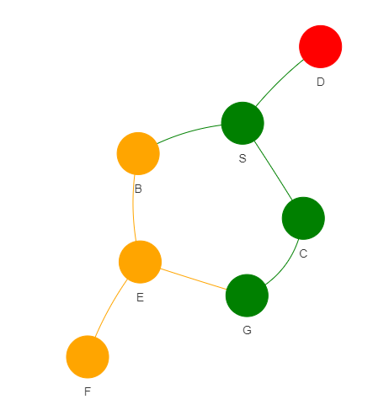

2- Depth First search
How the implemented algorithm handles this graph
Initially S enters the Stack as it is not the goal it is added to the visited list then expanded getting its children B-C-D. as it is LIFO D is visited first
D is then visited and as it is not the goal it is added to the visited list.
C is then visited and as it is not the goal it is added to the visited list then expanded getting its child G.
Next in the Stack is G which is the goal so the goal is marked as reached and the solution path is generated
G has two parents E-C however the algorithm recognizes the last expanded parent and returns that parent in the solution path

Slide 11
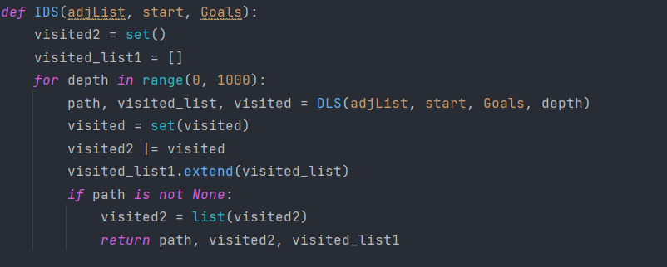
3-Iterative Deepening Search
The iterative deepening search works by calling an auxiliary method called depth limited search with sending each time the graph and a limit to the depth the search algorithm can reach in the graph. Theoretically the upper limit of iter ations is infinite buy we set it here to 1000. Based on the value returned from that auxiliary function if the path is specified (i.e. not None) then a goal was found thus the iterative deepening search breaks from the loop and returns the path, and list of visited nodes through out the whole operation of the algorithm.

Slide 12
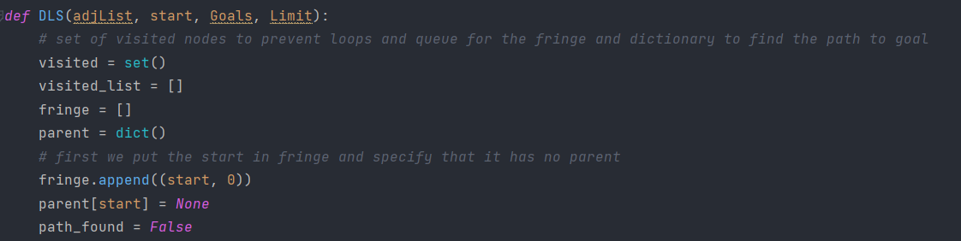
3.1- Depth limited search
Initialization
Creating a list to hold the visited nodes so we can return the visited nodes in order
Creating a set to hold the visited nodes
Creating a dictionary to hold the parent of each node reached in the graph. Will be used to get the solution path at the end.
Adding the start node to the fringe, with specifying that its depth is zero.

Slide 13
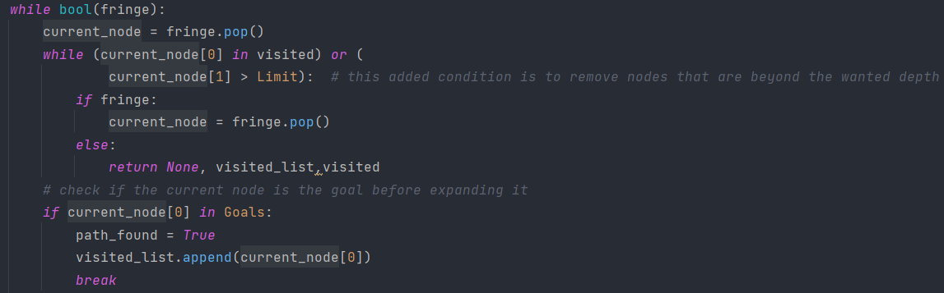
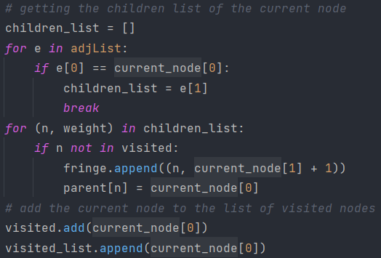
3-Iterative Deepening search
Looping
Popping the last node to enter the fringe
Check if the current node is a goal. If so set that the goal is found and exit from the loop
Get the node that is supposed to be expanded and make sure it isn’t visited before, and its depth is within the allowed limit.
Depth of parent + 1
For each child of the current node we check if it isn’t visited and add it to the fringe with setting its parent as the current node being expanded. And we add that this node is reached through which parent node in the dictionary
Add the current node to the list of visited nodes.

Slide 14
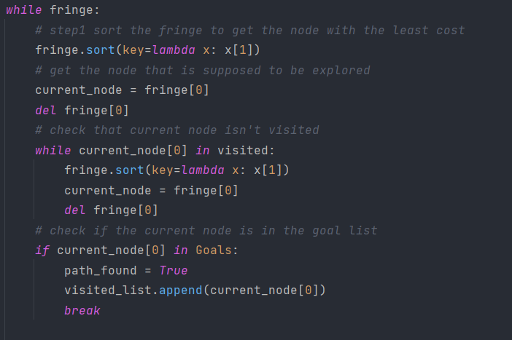
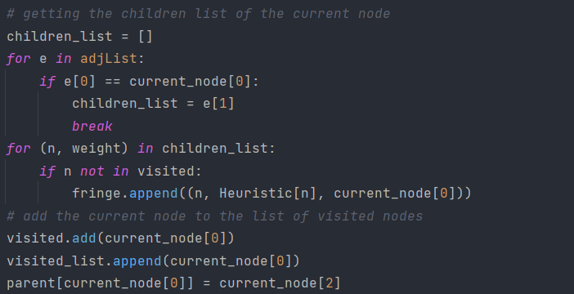
3-Iterative Deepening search
Sort the fringe in ascending order based on the node heuristic
Get the node that is supposed to be expanded and make sure it isn’t visited before.
Check if the current node is a goal. If so set that the goal is found and exit from the loop
For each child of the current node we check if it isn’t visited and add it to the fringe with setting its parent as the current node being expanded and the parameter by which the fringe will be sorted based on as the node heuristic
Heuristic of node
Add the current node to the list of visited nodes and set its parent in the dictionary.

Slide 15

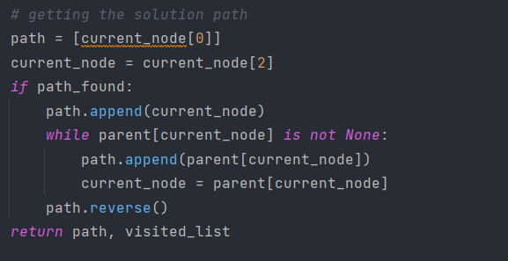
3-Iterative Deepening search
Finding the path to goal
Check if the goal isn’t found then the depth is not enough and return the list of visited nodes with specifying that the goal isn’t found through returning none in the place of the path to the goal.
If we exited the while loop due to finding a goal the we enter this loop that uses the dictionary called parent to find the solution path by inserting the nodes from the goal up to the starting node in a list then reversing the list

Slide 16
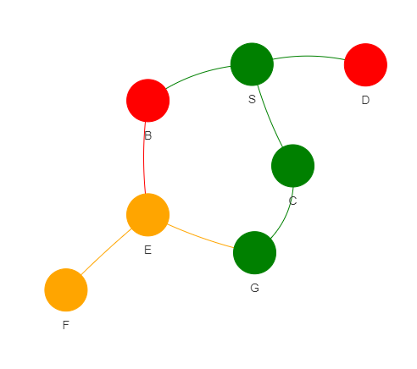

3-Iterative Deepening search
How the implemented algorithm handles this graph
Initially S enters the Stack as it is not the goal it is added to the visited list then expanded getting its children B-C-D depth = 0 so we proceed to next iteration.
S is then visited and as it is not the goal it is added to the visited list then expanded getting its children B-C-D.
D is then visited and as it is not the goal it is added to the visited list.
C is then visited and as it is not the goal it is added to the visited list then expanded getting its child G.
B is then visited and as it is not the goal it is added to the visited list then expanded getting its child E. depth =1 so we proceed to next iteration.
In this iteration S-D-C are expanded then G is next which is the goal

Slide 17
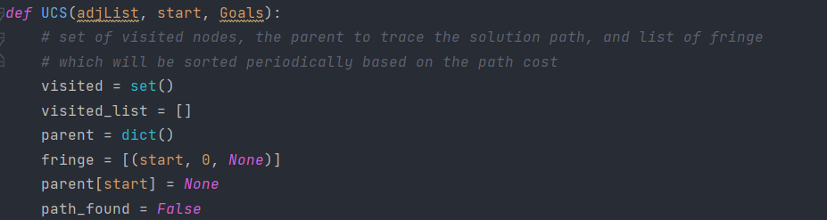
4- Uniform cost search
Initialization
Creating a list to hold the visited nodes so we can return the visited nodes in order
Creating a set to hold the visited nodes
Creating a dictionary to hold the parent of each node reached in the graph. Will be used to get the solution path at the end.
Adding the start node to the fringe, with specifying that the weight to reach it is zero and it has no parent.

Slide 18
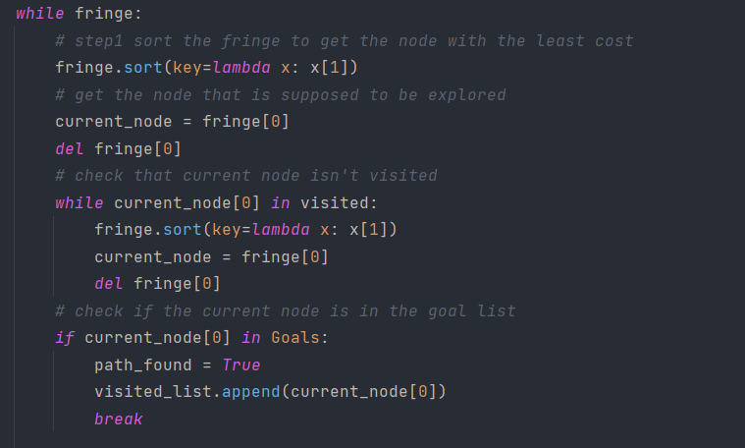
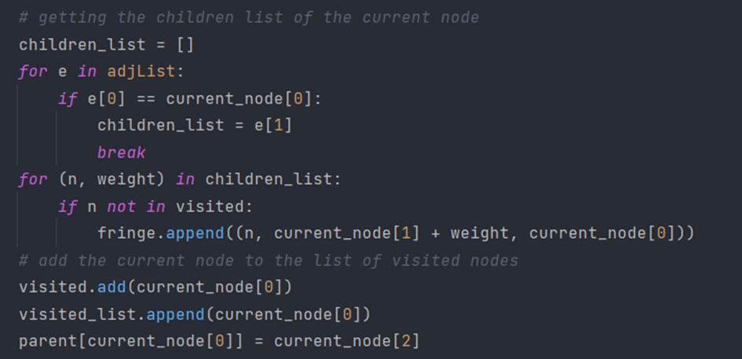
4- Uniform cost search
Sort the fringe in ascending order based on the cost to reach that specific node
Looping
Get the node that is supposed to be expanded and make sure it isn’t visited before.
Check if the current node is a goal. If so set that the goal is found and exit from the loop
For each child of the current node we check if it isn’t visited and add it to the fringe with setting its parent as the current node being expanded and the path cost to reach it = path to parent + (parent to child)
Weight to reach node
Add the current node to the list of visited nodes and set its parent in the dictionary.

Slide 19
4- Uniform cost search
Finding the path to goal
If we exited the while loop due to finding a goal the we enter this loop that uses the dictionary called parent to find the solution path by inserting the nodes from the goal up to the starting node in a list then reversing the list

Slide 20
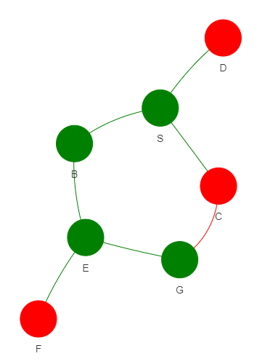

4-Uniform cost search
How the implemented algorithm handles this graph
Initially we start at S we expand getting its children B-C-D.
Next C is visited and expanded as it has the lowest cost from the start (W=1).
Next B is visited and expanded as it has the lowest cost from the start (W=2)
Next E is visited and expanded as it has the lowest cost from the start (W=9)
Next D is visited and expanded as it has the lowest from the start (W=10)
Next F is visited and expanded as it has the lowest cost from the Start (W=10)
Next G is visited as it has the lowest cost from the start (W=11)
The algorithm returns the path with the minimum cost from the start to goal which is the first path discovered.
In case of a tie the tie breaking is randomized.

Slide 21
Informed Search

Slide 22
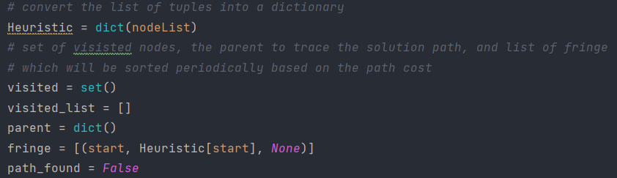
5-Greedy Search
It is worth noting that the greedy search is almost the same as uniform cost search except that the fringe is sorted based on the heuristic of the node rather than the path cost to reach it.
Creating a set to hold the visited nodes
Initialization
Convert the list of nodes received into a dictionary to map each node with its corresponding heuristic
Creating a dictionary to hold the parent of each node reached in the graph. Will be used to get the solution path at the end.
Adding the start node to the fringe, with specifying that it has no parent.
Creating a list to hold the visited nodes so we can return the visited nodes in order

Slide 23
5-Greedy search
Sort the fringe in ascending order based on the node heuristic
Looping
Get the node that is supposed to be expanded and make sure it isn’t visited before.
Check if the current node is a goal. If so set that the goal is found and exit from the loop
For each child of the current node we check if it isn’t visited and add it to the fringe with setting its parent as the current node being expanded and the parameter by which the fringe will be sorted based on as the node heuristic
Heuristic of node
Add the current node to the list of visited nodes and set its parent in the dictionary.

Slide 24
5-Greedy search
Finding the path to goal
If we exited the while loop due to finding a goal the we enter this loop that uses the dictionary called parent to find the solution path by inserting the nodes from the goal up to the starting node in a list then reversing the list

Slide 25
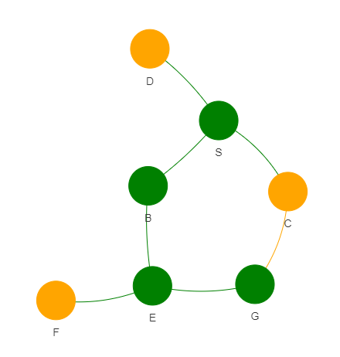

5-Greedy search
How the implemented algorithm handles this graph
Initially we start at S we expand getting its children B-C-D.
Next B is visited and expanded as it is the node which can be reached has the lowest heuristic from the current node (S) (h=7).
Next E is visited and expanded as it is the node which can be reached has the lowest heuristic from the current node(B) (h=1).
Next G is visited which is the goal as it is the node which can be reached has the lowest heuristic from the current node (E) (h=0).
In case of a tie the tie breaking is randomized.

Slide 26
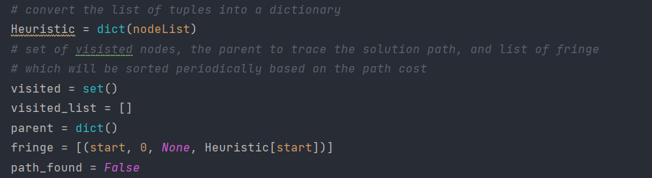
6-A* Search
It is worth noting that the A* search is almost the same as uniform cost search except that the fringe is sorted based on the heuristic of the node plus the path cost till that node, rather than the path cost to reach it.
Creating a set to hold the visited nodes
Initialization
Convert the list of nodes received into a dictionary to map each node with its corresponding heuristic
Creating a dictionary to hold the parent of each node reached in the graph. Will be used to get the solution path at the end.
Adding the start node to the fringe, with specifying that it has no parent, setting its cost to zero and the heuristic to the start node heuristic
Creating a list to hold the visited nodes so we can return the visited nodes in order

Slide 27
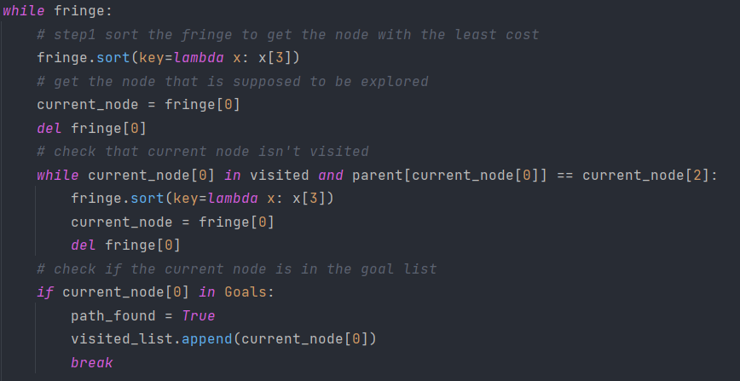
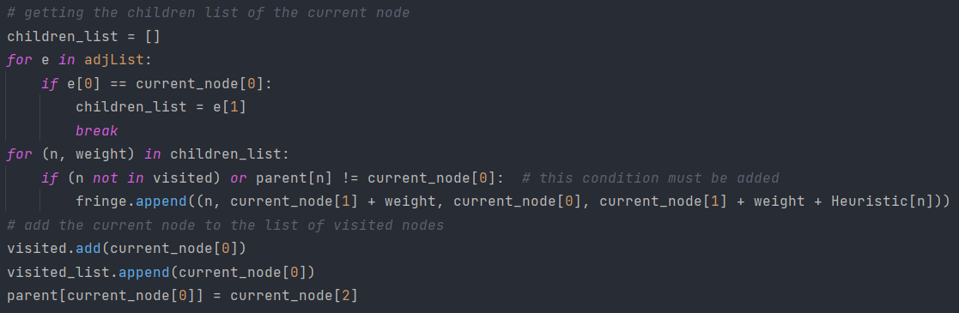
6-A* search
Sort the fringe in ascending order based on the node heuristic + cost to reach the node
Looping
Get the node that is supposed to be expanded and make sure it isn’t visited before.
Check if the current node is a goal. If so set that the goal is found and exit from the loop
For each child of the current node we check if it isn’t visited and add it to the fringe with setting its parent as the current node being expanded and the parameter by which the fringe will be sorted based on as the node heuristic + cost to reach the node
Cost to reach current node
Cost to reach current node+ node heuristic
Add the current node to the list of visited nodes and set its parent in the dictionary.

Slide 28
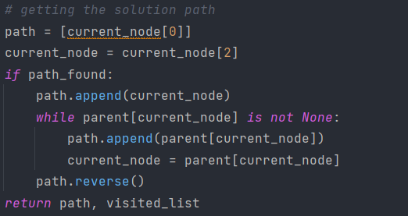
6-A* search
Finding the path to goal
If we exited the while loop due to finding a goal the we enter this loop that uses the dictionary called parent to find the solution path by inserting the nodes from the goal up to the starting node in a list then reversing the list

Slide 29
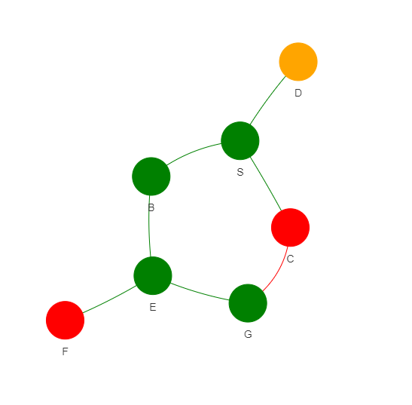

6-A* search
How the implemented algorithm handles this graph
Initially we start at S we expand getting its children B-C-D.
Next B is visited and expanded as it is the node has the lowest value (2+7)
Next E is visited and expanded as it is the node which can be reached has the lowest value (9+1)
Next C is visited and expanded as it is the node which can be reached has the lowest value (1+10)
Next F is visited and expanded as it is the node which can be reached has the lowest value (10+1)
Next G is visited which is the goal as it is the node which can be reached has the lowest value (11+0)
In case of a tie the tie breaking is randomized.

Slide 30
Pyvis and the GUI

Slide 34
Undirected Graph

Slide 35
Breadth First Search Result

Slide 36
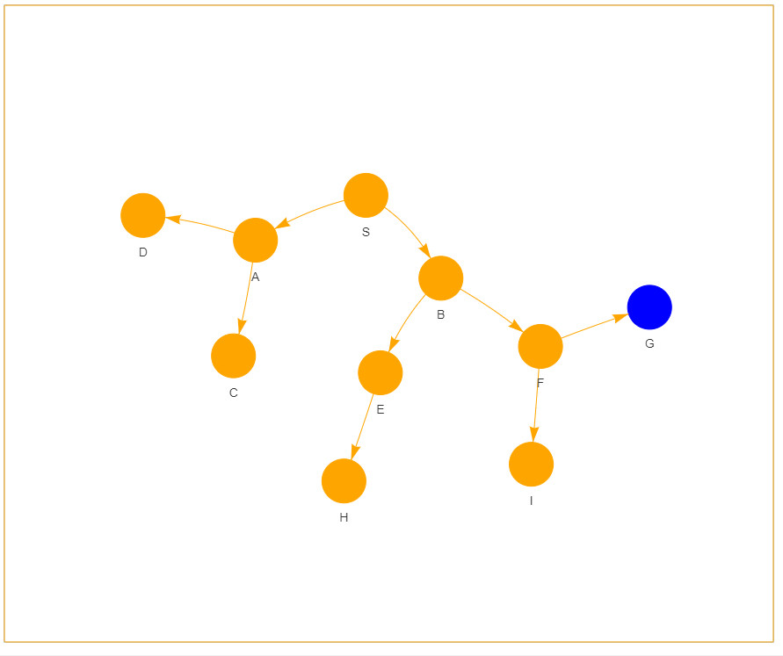
Directed Graph

Slide 37
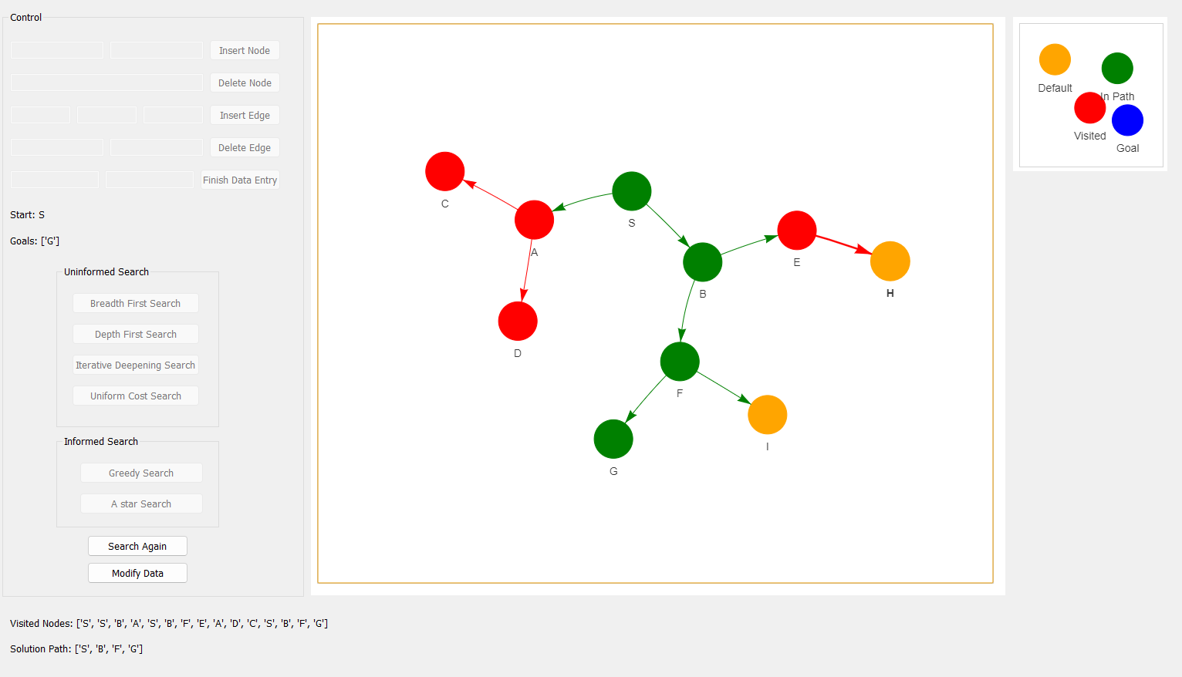
Iterative Deepening Search Result

